Slide 1
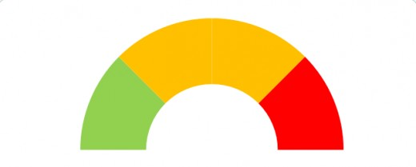
Trend Monitoring – Competitor New Product Development
Primary Indicators
Estimated Timing
(List Disruptor Here)
Academic Research
Funding
Personnel Moves
IP Filings
Partnerships/Supplier Relationships
Increased HCP Contacts
Clinical Trials
Regulatory Filings
Code Submission
Marketing Activities
M&A Activities
2018
2019
2020
2021
2022
Risk Assessment
Minimal
Threat
Immediate
Threat
Previous
Current
Assessment of Action Required
Plan
Monitor
Act
Analysis
Include a summary analysis of the indicators you are monitoring.
Focus on providing “So What” and “What now” intelligence rather than reporting “What happened”
Key
Unobserved
Identified Activity
Confirmed or Significant Activity
Change Since Last Quarter

